Slide 1

Training module
A guide to the television monitoring
Section 1: The story

Slide 2
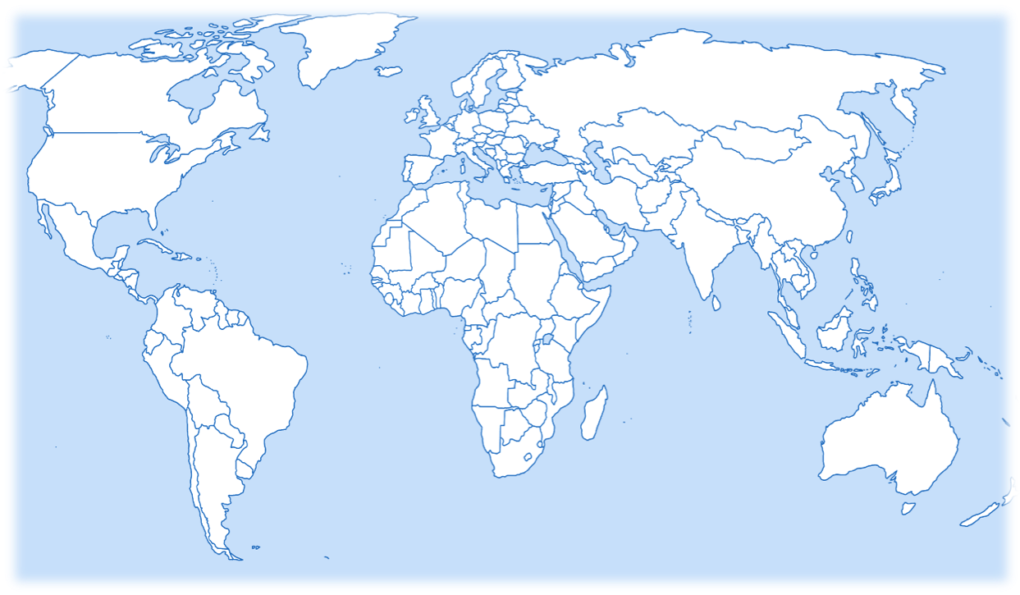
An international initiative…
Media monitoring is taking place in over 100 different countries across the globe. For this reason, it is critical that all participants have a uniform understanding of the way the monitoring materials should be applied. Please use this presentation as a means of familiarising yourself with the materials and becoming comfortable with their application.

Slide 3
Starting off
To begin coding you will need:
A pencil (not pen)
An eraser
A television news cast
A television coding sheet
If you can, code in Excel.

Slide 4
Guidelines
In this tutorial we will carry out the full monitoring and therefore will use the coding grid and questions for the full monitoring.
If you are doing the short monitoring, make sure you select the short monitoring coding guide and grid.
In both cases;
  Read the TV transcript to the right and then respond to the questions on the subsequent slides.
  After each question, the answer will be shown and an explanation will be given.
  The transcript will remain in the right hand pane for the duration of the training. Good luck!

Slide 5
Femi Oke (female anchor) : Let’s go to Namibia.
Netumbo Nandi-Ndaitwah (President of Namibia) : “So help me God”.
Famida Miller (Al Jazeera journalist): Netumbo Nandi Ndaitwah becomes Namibia’s first female president after her governing SWAPO party, won parliamentary and presidential elections in November. While Namibia has seen relatively strong economic growth in recent years, largely due to investments in oil, gas and green hydrogen, the World Bank says it ranks second highest globally for income inequality.
Netumbo Nandi-Ndaitwah: “We pledge to the people of Namibia to diversify our economy for our people, to drive maximum benefit from our country’s natural resources through value additions.
Famida Miller: The seventy-two-year-old wants to diversify Namibia's resource-based economy to tackle high unemployment. SWAPO has been in power for 35 years, but its support has fallen in the last decade because of dissatisfaction with not only joblessness but also allegations of corruption. The party secured 57% of the votes in November's presidential race compared to 87% in 2014. Opposition parties claimed the vote was flawed.
Famida Miller: A fairly muted swearing in ceremony in the capital Windhoek was attended by regional leaders, including South Africa's President Cyril Ramaphosa. Nandi-Ndaitwah is only one of two female heads of state in Africa. Last year she became the first woman to lead Suapo after holding several senior posts, including deputy prime minister, during her decades long political career in the Liberation movement.
Al Jazeera English/ March 22, 2025.

Slide 6
BASIC INFORMATION
In the top right-hand corner of the Coding Sheet, enter:
your monitor code
your country code
the name of the television channel
the newscast start time
the number of female anchors, and male anchors, in the entire newscast (you will have to watch the whole newscast before you can enter the number of anchors)

Slide 7

Question 1
Item number. (Simply write where the item fell in the entire newscast.)
This story was third in the newscast. Code 3.

Slide 8
Question 2
What is the topic of this story?
1. Women politicians, women electoral candidates..
3. Other domestic politics, government, etc.
8. Economic policies, strategies, modules, indicators, stock markets, taxes, etc
11. Women’s participation in economic processes
When there is more than one answer that seems like it might fit, choose the best of the options.
In this case, the most correct answer is: ‘women politicians, women electoral candidates.’

Slide 9
Question 3
What is the scope of this story, assuming you are coding in Namibia?
The event is a national event.
Always code according to the widest applicable geographical scope. If an event has both national and local importance, code it as national.
Additionally, code the scope from your own perspective in the country where you live.
1. Local
2. National
3. Sub regional and Regional
4. Foreign/International

Slide 10
Section 2: Analysis

Slide 11
Question 4
Does this story make reference to any piece of legislation or policy on gender equality or human rights?
1. Yes
2. No
The story makes no reference to legislation or policy on gender equality policy or human rights. Code 2

Slide 12
Question 5
Is the story about a particular woman or group of women?
1. Yes
2. No
Yes, this story is about the election and pledge of female politician Netumbo Nandi-Ndaitwah. Code 1.

Slide 13
Question 6
To what extent do you agree with the following statement:
“This story clearly highlights issues of inequality between women and men?”
1. Agree
2. Disagree
This story does not highlight issues of inequality between women and men. Code 2

Slide 14
Question 7
To what extent do you agree with the following statement:
“This story clearly challenges gender stereotypes.”
1. Agree
2. Disagree
The story, language and images clearly challenge gender stereotypes. The news clip begins with the camera showing the swearing in of the newly elected President Nandi-Ndaitwah, first female president of the country and second acting president of Africa. She has at her back a female military officer and female guards.
The journalist explicitly highlights the fact that she is Namibia’s first female president.
Code 1.

Slide 15

Section 3: Journalists/Reporters

Slide 16
Guidelines
For this example, there are two people:
-one anchor
- One journalist/reporter
Remember all the anchors/reporters in the news should be coded. (See the full monitoring guides for further guidance on determining who to code and who not to code.
Each person is given their own row on the coding sheets.

Slide 17
Questions 8 to 10
The anchor who introduced this story is Femi Oke. In columns 8-10, enter the code
8 -Role – 1 – anchor/announcer
9 - Sex – 1 – female
10 - Age – 0 – do not know

Slide 18
Section 4: People in the news

Slide 19
Guidelines
In this example there is:
-One ‘people in the news’ to code.
Remember all the people in the story should be coded. (See the full monitoring guides for further guidance on determining who to code and who not to code.
Each person is given their own row on the coding sheets.

Slide 20
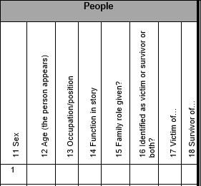
Question 11
There is one person to code in this story, President Netumbo Nandi-Ndaitwah. Since Nandi-Ndaitwah is the sole person in the story we only code her.
What sex is President Nandi-Ndaitwah?
2. Male
1. Female
3. Other transgender, gender non-conforming, non-binary, two-spirit, third gender..
4. Do not know
President Nandi-Ndaitwah is a woman.

Slide 21
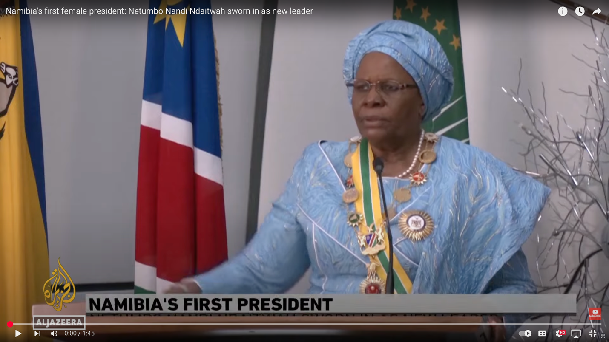
Question 12
How old does President Nandi-Ndaitwah appear to be?
0. Do not know
1. 12 and under
2. 13-18
3. 19-34
4. 35-49
5. 50-64
6. 65-79
7. 80 and up
In this case the age of Nandi-Ndaitwah is given by the article, she is 72 years old.
If in doubt, discuss and code with a partner. This is one way to ensure the reliability of your coding decisions and of the GMMP’s results.

Slide 22
Question 13
What is President Nandi-Ndaitwah’s occupation or position?
1. Royalty, monarch, deposed monarch, etc..
2. Politician/ member of parliament, …
3. Government employee, public servant, etc.
She is the President of Namibia. Code 2.
18. Celebrity, artist, actor, writer, singer, TV personality
27. Other

Slide 23
Question 14
In what function or capacity is President Nandi-Ndaitwah included in the story?
0. Do not know
1. Subject
2. Spokesperson
3. Expert or commentator
4. Personal experience
She is the subject of the story – the story is about her as newly elected President.
5. Eyewitness
6. Popular opinion
7. Other

Slide 24
Question 15
Is President Nandi-Ndaitwah described, at any point within the story, in terms of family relationships? (wife, mother, daughter, etc.)
1. Yes
2. No
In this report, she is not described in terms of her family relationships. Code 2.
Even if you are aware that the person is married, has children, etc, you should only code what is explicitly stated in the report.

Slide 25
Question 16
Does the story identify the person either as a victim or survivor, or both?
1 Yes
2. No*
President Nandi-Ndaitwah is neither identified as a victim nor survivor. Enter code ‘2’ under Question 16.
Code a person as a victim or survivor either if the word ‘victim’ or 'survivor' is used to describe her/him, or if the story implies that the person is a victim/survivor - e.g. by using language or images that evoke particular emotions such as pity, admiration or respect for the person.
*IF YOU SELECT 2 (“NO”) IN Q.16, SKIP TO Q.19*
Complete Questions 17 and 18 if the person is described as victim or survivor

Slide 26
Question 17
Does the story identify Nandi-Ndaitwah as a victim?
Skip this question
Question 18
We answered ‘2, Not a victim or survivor in Q. 16.
Skip questions 17 and 18.
Does the story identify Nandi-Ndaitwah as a survivor?
Skip this question

Slide 27

QUESTION 19
Is Nandi-Ndaitwah depicted as part of a minority group?
1. Yes
2. No
Nandi-Ndaitwah is not presented as part of a minority group.

Slide 28


Question 20
Special Q1. Is the story about youth violence?
1. Yes
No. It’s not mentioned in the text or visible in the images.

Slide 29
Question 21
Special Q2. Is the person referred to as an immigrant/refugee, whether mentioned in the text or visible in the images?
1. Yes
No. It’s not mentioned in the text or visible in the images.

Slide 30


Question 22
Special Q3. Is the person referred to a member of LGBTQIA+ community?
No, President Nandi-Ndaitwah is not depicted as a member of the LGBTQ+ community.

Slide 31
If there were a second person in this story then we would do the same set of questions for that person. If there were a third person, we would do the same for the third person, etc. Each person would be coded in a different row.

Slide 32

Section 5: Other

Slide 33
Question 23
Does this story warrant further analysis?
This story is interesting for analysis of the ways in which female politicians are portrayed in the media. In this case, President Nandi-Ndaitwah’s portrayal is fair and balanced. The tendency for sexist coverage is absent here, unlike in other documented cases of media portrayals of women in politics. The images and narrative focus on her promise to reform Namibia’s economy to benefit it’s people. It is possible to Code 1
Enter your comments in the space provided for comments and explanations.
1. Yes
2. No

Slide 34
Code all persons in the story.
- Use a new row for each person.
- And skip a line to code next story.

Slide 35
Comments & Explanations

