Slide 1

TRAINING MODULE
A guide to the newspaper monitoring

Slide 2
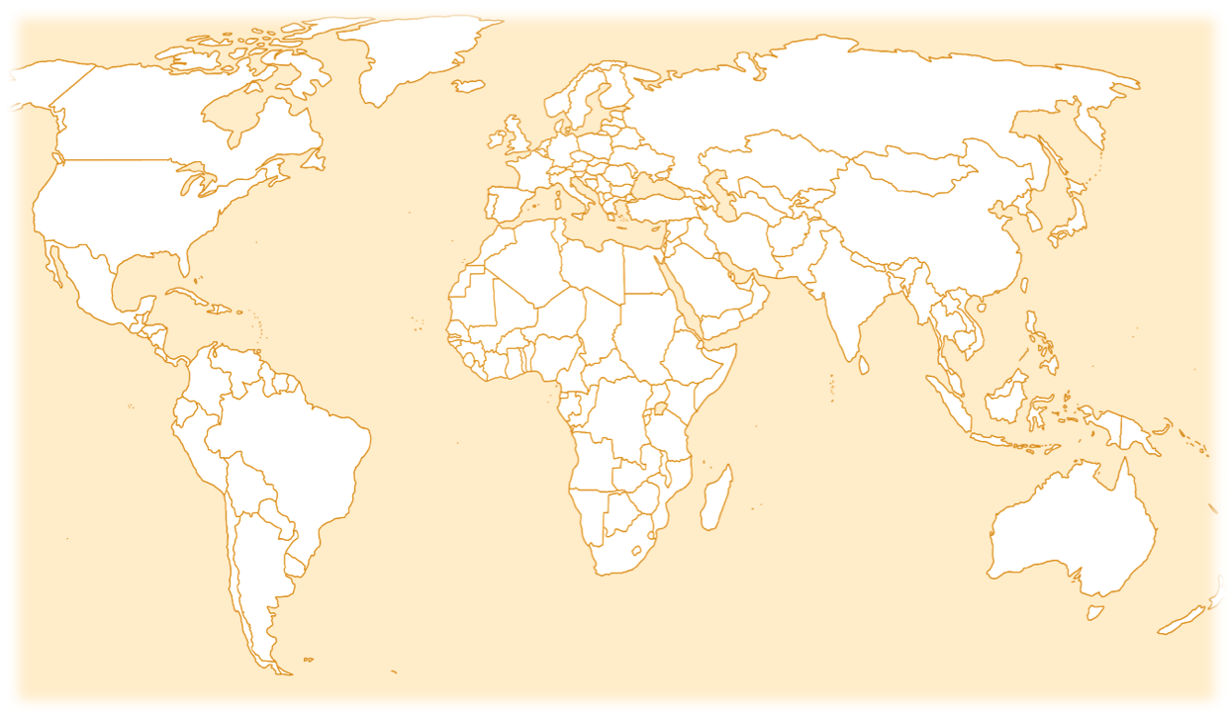
AN INTERNATIONAL INITIATIVE…
Because media monitoring is taking place in over 100 different countries across the globe, it is critical that all participants have a uniform understanding of the way the monitoring materials should be applied. Please use this presentation as a means of familiarising yourself with the materials and becoming comfortable with their application.

Slide 3
STARTING OFF
To begin coding you will need:
A pencil (not pen)
An eraser
The newspaper
A newspaper coding sheet
If you can, code in Excel.

Slide 4
GUIDELINES
In this tutorial we will carry out the full monitoring and therefore will use the coding grid and questions for the full monitoring.
If you are doing the short monitoring, make sure you select the short monitoring coding guide and grid.
In both cases:
  Read the article on the next slide and then respond to the questions after the story.
  After each question, the correct answer will be shown and an explanation will be given.
  The article will remain in the right hand pane for the duration of the quiz. Good luck!

Slide 6

BASIC INFORMATION
In the top right-hand corner of the Coding Sheet, enter:
your monitor code
your country code
the name of the newspaper

Slide 7
Section 1: The story

Slide 8
QUESTION 1
Page number. (Simply write the number of the page on which the story begins.)
In this case, page one.

Slide 9
QUESTION 2
What is the topic of this story?
16. Consumer issues, protection.
20. Science, technology, research, discoveries…
21. Medicine, health, hygiene, safety…
When there is more than one answer that seems like it might fit, choose the best of the two.
In this case, the most correct answer is: ‘Science, technology, discoveries, etc.‘. There may be other topics that are close, but this is the best topic.
Code 'other' only as a last resort when none of the other listings seems at all appropriate.

Slide 10
QUESTION 3
What is the scope of this story, assuming you are coding in the UK?
1. Local
2. National
3. Sub-Regional and Regional
4.Foreign/ International
This is a French national news story, that is published in the UK. The event occurs in France and applies to French Schools. Published in the UK, the story’s scope is international (code 4) as there are not direct effects outside of France.

Slide 11
QUESTION 4
How much space does this story occupy on the page?
1. Full page
2. Half page
3. One third page
4. Quarter page
5. Less than quarter page
This story occupies quarter of a page. Code ‘4. Quarter page’.

Slide 12

Section 2: Analysis

Slide 13
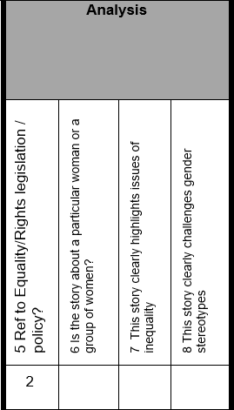
QUESTION 5
Reference to gender equality/ human rights legislation / policy.
1. Yes
2. No
This story makes no mention of any specific legislation or policy on gender equality or human rights. Code 2.

Slide 14
QUESTION 6
Is the story about a particular woman or group of women?
1. Yes
2. No
No, the story is about educational policy with no reference to gender or gender groups.

Slide 15
QUESTION 7
This story clearly highlights issues of inequality between women and men?
1. Agree
2. Disagree
No, no explicit reference is made about gender, or differences among genders, in relation to this issue.

Slide 16
QUESTION 8
This story clearly challenges gender stereotypes.
1. Agree
2. Disagree
No. The article makes no reference to gender or gender differences.

Slide 17

Section 3: Journalists & Reporters

Slide 18

QUESTION 9
JOURNALIST OR REPORTER
What sex is the reporter?
(The information is provided by Angelique Chrisafis)
1. Female
2. Male
3. Other (transgender, gender non-conforming, non-binary, two-spirit, third gender
4. Do not know
**If there was a second reporter, she or he would be coded on the next row. Since there are no other reporters in the story, we move on to the next section of the coding sheet.
When news agencies are providing the information, leave the space blank.
If the reporter’s name is given, but it is unclear whether they are male or female, the correct code is ‘do not know.’

Slide 19
Section 4: People in the news

Slide 20
GUIDELINES
For this portion of the guide, we provide examples for one person in the story, Elizabeth Borne.
When you are coding the news, you will need to supply information on all of the people that appear in every story.
Each person is given their own row on the coding sheets. Click to proceed.

Slide 21

QUESTION 10
What is Elizabeth Borne`s sex?
2. Male
1. Female
3. Gender diverse, including transgender, etc.
4. Do not know
Elizabeth Borne is a woman.
If it is not clear from an individual's name whether they are male or female, code 4.

Slide 22
QUESTION 11
What is Elizabeth Borne`s age, if mentioned?
0. Do not know
1. 12 years or under
2. 13-19
3. 20-30
4. 31-50
5. 51-64
6. 65-79
7. 80+
Elizabeth Borne’s age is not mentioned in the story.
Even if you know the age of the person concerned, if this person's age is not explicitly stated in the story, you must code 0.

Slide 23
QUESTION 12
What is Elizabeth Borne`s occupation or position?
2. Politician, member of parliament.
3. Government employee, public servant, spokesperson.
4. Police, military, para-military, militia, fire officer.
5. Academic expert, lecturer, teacher
Elizabeth Borne is the Education Minister, therefore she would be coded as “3” Government employee, public servant, spokesperson.

Slide 24
QUESTION 13
In what function or capacity is Elizabeth Borne included in the story?
0. Do not know
1. Subject
2. Spokesperson
3. Expert or commentator
4. Personal experience
5. Eyewitness
6. Popular opinion
7. Other
Elizabeth Borne is explaining the rationale for new a measure regarding education. Code ‘2. Spokesperson’

Slide 25
QUESTION 14
Is Elizabeth Borne’s family role given (e.g. mother, wife, daughter, aunt, etc.)?
1. Yes
2. No
Elizabeth Borne’s family is not mentioned..

Slide 26
QUESTION 15
Is Elizabeth Borne identified as a victim or survivor, or both?
1. Yes
2. No*
Elizabeth Borne is neither identified as a ‘victim’ nor as a ‘survivor’.
Complete Q16 and Q17 if the person is described as victim or survivor.
*If you select 2 (No) in Question 15, skip to Q.18.

Slide 27
QUESTION 16
Does the story identify the person as a victim of any of the following?
0. Not applicable (person is identified solely as a survivor)
1. Victim of an accident, natural disaster, poverty
Code a person as a victim either if the word 'victim' is used to describe her/him, or if the story implies that the person is a victim - e.g. by using language or images that evoke particular emotions such as shock, horror, sympathy for the person
Skip this question if you coded ‘2’ in Question 15.

Slide 28
QUESTION 17
Does the story clearly identify the person as a survivor of any of the following?
0 Not applicable (person is identified solely as a victim)
1 Survivor of an accident, natural disaster, poverty
Code a person as a survivor either if the word ‘survivor' is used to describe her/him, or if the story implies that the person is a survivor.
Skip this question if you coded ‘2’ in question 15.

Slide 29
QUESTION 18
Is Elizabeth Borne directly quoted in the story?
1. Yes
2. No
Elizabeth Borne is directly quoted in the story.

Slide 30
QUESTION 19
Is Elizabeth Borne depicted as part of a minority group?
1. Yes
2. No
Elizabeth Borne is not presented as part of a minority group.

Slide 31

QUESTION 20
Is there a photograph of Elizabeth Borne in the story?
1. Yes
2. No
3. Don’t know (e.g. there is a photo, but you are not sure if Borne appears in it)
Elizabeth Borne does not appear in the photo.
N.B. When an article is accompanied by a photo, be sure to describe that photo in the designated portion of the comments section. Specify, also, the conclusions that you draw from the picture. Who is pictured? Why them? What does the perspective tell us? Etc.

Slide 32
QUESTION 21-23
Your national coordinator will have assigned different questions for Special Q1, Special Q2 and Special Q3.
Refer to the instructions given to you by the coordinator.

Slide 33


QUESTION 21
Eg. Special Q1 Does the text refer to youth violence?
whether mentioned in the text or visible in the images?
1. Yes
No. The text does not mention youth violence.

Slide 34

QUESTION 22
Eg. Special Q2 Is the person referred to as an immigrant or refugee?
No. It’s not mentioned in the text or visible in the images.

Slide 35


QUESTION 23
Eg. Special Q3 Is the person identified as part of the LGBTQIA+ community?
No.

Slide 36
Code all persons in the story.
- Use a new row for each person.
- And skip a line to code next story.

Slide 37
Section 5: Other

Slide 38


QUESTION 24
Does this story warrant further analysis?
Why or why not?
1. Yes*
This story can be seen as the representation of women in positions of power. Therefore, further analysis of this news item and other news items like this one that depict women in positions of power, may be interest.
*If your answer is ‘1’ (Yes), you will need to send a copy of the clipping to your national/regional coordinator.
Enter your comments in the comments column.

