Slide 1

Training module
A guide to the newspaper monitoring

Slide 2
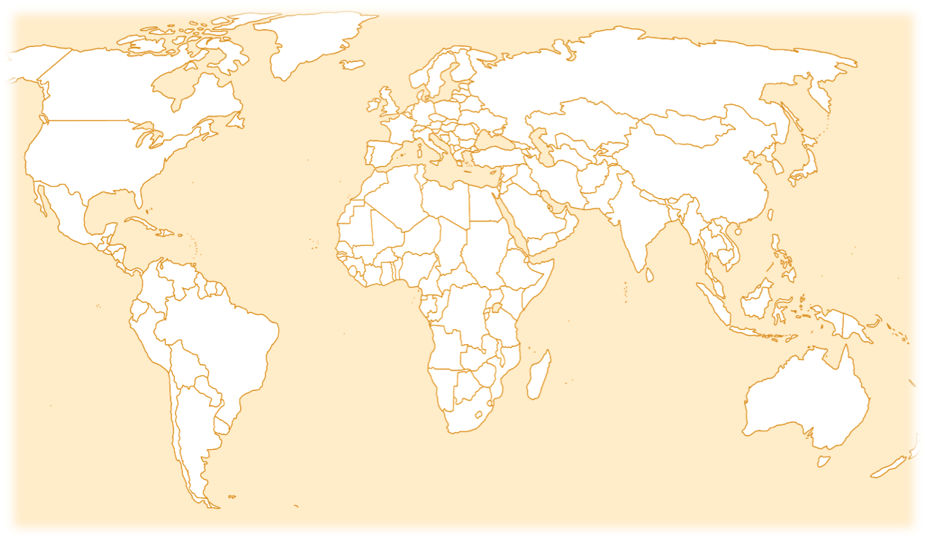
An international initiative…
Because media monitoring is taking place in over 100 different countries across the globe, it is critical that all participants have a uniform understanding of the way the monitoring materials should be applied. Please use this presentation as a means of familiarising yourself with the materials and becoming comfortable with their application.

Slide 3
STARTING OFF
To begin coding you will need:
A pencil (not pen)
An eraser
A copy of the internet news
An internet coding sheet
If you can, code in Excel.

Slide 4
Guidelines
In this tutorial we will carry out the full monitoring and therefore will use the coding grid and questions for the full monitoring.
If you are doing the short monitoring, make sure you select the short monitoring coding guide and grid.
In both cases:
  Read the article on the next slide and then respond to the questions after the story.
  After each question, the correct answer will be shown and an explanation will be given.
  The article will remain in the right hand pane for the duration of the quiz. Good luck!

Slide 6

BASIC INFORMATION
In the top right-hand corner of the Coding Sheet, enter:
your monitor code
your country code
the website name
the URL
the date and time accessed
whether publication is available as a print newspaper (offline presence)

Slide 7
Section 1: The story

Slide 8
Question 1
Webpage layer number.
Write in the layer number on which the story begins. For example, indicate ‘1’ for stories beginning on the homepage.
This story starts on the website’s home page. Code 1

Slide 9
Question 2
When there is more than one answer that seems like it might fit, choose the best of the two.
In this case, the most correct answer is: ‘Riots, demonstrations, public order, etc. ‘, none of the other alternatives fit as well..’
Code 'other' only as a last resort when none of the other listings seems at all appropriate.
What is the topic of this story?
40. Legal system, judiciary, legislation, family law, family codes, property law, inheritance…
41. Disaster, accident, famine, flood, plane crash, etc.
42. Riots, demonstrations, public disorder, etc.

Slide 10
Question 3
This is news story from Serbia, reported by a regional news site about an event in Serbia, but with effects on the EU and its parliament. The methodology guide asks us to code the widest geographical code that applies therefore,
Coders would then select ‘3. Sub-Regional and Regional’.
What is the scope of this story, assuming you are coding in Kosovo?
(The story was published in a newspaper from Serbia and takes place in the same country.)
1. Local
2. National
3. Sub-Regional and Regional
4.Foreign/ International

Slide 11

Section 2: Analysis

Slide 12
Question 5
This story makes no mention of any specific legislation or policy on gender equality or human rights. Code 2.
Reference to gender equality/ human rights legislation / policy.
1. Yes
2. No

Slide 13
Question 6
No, this story is about mass demonstrations in Serbia and how the European Parliament sees these events.
Is the story about a particular woman or group of women?
1. Yes
2. No

Slide 14
Question 7
The story makes no reference to issues of inequality between men and women’.
So, the best code is “disagree”.
This story clearly highlights issues of inequality between women and men?
1. Agree
2. Disagree

Slide 15
Question 8
This story does not reference gender and therefore does not challenge this type of stereotype.
This story clearly challenges gender stereotypes.
1. Agree
2. Disagree

Slide 16
Section 3: Journalists & Reporters

Slide 17
Question 9
Journalist or reporter
When news agencies are providing the information, leave the space blank.
If the reporter’s name is given, but it is unclear whether they are male or female, the correct code is ‘do not know.’
What sex is the reporter?
(The information is provided by Katerina Batelic)
1. Female
2. Male
3. Gender diverse, including transgender.
4. Do not know
**If there was a second reporter, she or he would be coded on the next row. Since there are no other reporters in the story, we move on to the next section of the coding sheet.

Slide 18
Question 10
The reporter’s age is not mentioned in the story.
Even if you know the age of the person concerned, if this person's age is not explicitly stated in the story, you must code 0.
What is the reporter`s age, if mentioned?
0. Do not know
1. 12 years or under
2. 13-18
3. 19-34
4. 35-49
5. 50-64
6. 65-79
7. 80+

Slide 19

Section 4: People in the news

Slide 20
Guidelines
For this portion of the guide, we provide examples for one person in the story, Tonino Picula.
When you are coding the news, you will need to supply information on all of the people that appear in every story.
Each person is given their own row on the coding sheets. Click to proceed.

Slide 21

Question 11
Tonino Picula is a male.
If it is not clear from an individual's name whether they are male or female, code 4.
What is Tonino Picula`s sex?
1. Female
2. Male
3. Gender diverse, including transgender, etc.
4. Do not know

Slide 22
Question 11
Tonino Picul’s age is not mentioned in the story.
Even if you know the age of the person concerned, if this person's age is not explicitly stated in the story, you must code 0.
What is Tonino Picula`s age, if mentioned?
0. Do not know
1. 12 years or under
2. 13-18
3. 19-34
4. 35-49
5. 50-64
6. 65-79
7. 80+

Slide 23
Question 12
Tonino Picula is a member of the European Parliament. No other occupation is given. Code ‘2’.
What is Tonino Picula`s occupation or position?
2. Politician, member of parliament.
3. Government employee, public servant, spokesperson.
4. Police, military, para-military, militia, fire officer.
5. Academic expert, lecturer, teacher

Slide 24
Question 13
In what function or capacity is Tonino Picula included in the story?
Tonino Picula is communicating the European Parliament's position on recent events in Serbia. Code ‘2. Spokesperson’
0. Do not know
1. Subject
2. Spokesperson
3. Expert or commentator
4. Personal experience
5. Eyewitness
6. Popular opinion
7. Other

Slide 25
Question 14
Tonino Picula’s family is not mentioned.
Is Tonino Picula’s family role given (e.g. mother, wife, daughter, aunt, etc.)?
1. Yes
2. No

Slide 26
Question 15
Tonino Picula is neither identified as a ‘victim’ nor as a ‘survivor’.
Complete Q16 and Q17 if the person is described as victim or survivor.
If you select 2 (No) in Question 15, skip to Q.18.
Is Tonino Picula identified as a victim or survivor, or both?
1. Yes
2. No*

Slide 27
Question 16
Code a person as a victim either if the word 'victim' is used to describe her/him, or if the story implies that the person is a victim - e.g. by using language or images that evoke particular emotions such as shock, horror, sympathy for the person
Skip this question if you coded ‘2’ in Question 15.
Does the story identify the person as a victim of any of the following?
0. Not applicable (person is identified solely as a survivor)
1. Victim of an accident, natural disaster, poverty
8. Other victim (specify in ‘comments’).

Slide 28
Question 17
Code a person as a survivor either if the word ‘survivor' is used to describe her/him, or if the story implies that the person is a survivor.
Skip this question if you coded ‘2’ in question 15.
Does the story clearly identify the person as a survivor of any of the following?
0 Not applicable (person is identified solely as a victim)
1 Survivor of an accident, natural disaster, poverty
8 Other survivor (specify in ‘Comments’)

Slide 29
Question 18
Tonino Picula is directly quoted in the story.
Is Tonino Picula directly quoted in the story?
1. Yes
2. No

Slide 30

Question 19
Is Tonino Picula depicted as part of a minority group?
Tonino Picula is not depicted as member of a minority group. .
N.B. When an article is accompanied by a photo, be sure to describe that photo in the designated portion of the comments section. Specify, also, the conclusions that you draw from the picture. Who is pictured? Why them? What does the perspective tell us? Etc.
1. Yes
2. No
3. Don’t know

Slide 31
Question 20
Is there a photograph of Tonino Picula in the story?
Tonino Picula does not appear in the photo.
N.B. When an article is accompanied by a photo, be sure to describe that photo in the designated portion of the comments section. Specify, also, the conclusions that you draw from the picture. Who is pictured? Why them? What does the perspective tell us? Etc.
1. Yes
2. No
3. Don’t know (e.g. there is a photo, but you are not sure if Tonino appears in it)

Slide 32
Question 21-23
Your national coordinator will have assigned different questions for Special Q1, Special Q2 and Special Q3.
Refer to the instructions given to you by the coordinator.

Slide 33


Question 20
Eg. Special Q1 : Is the news item referred to youth violence ?
No. While the news event being described references some violent events it does not associate them with youth.
1. Yes

Slide 34

Question 21
No. It’s not mentioned in the text nor is it implied in the images.
Eg. Special Q2 : Is the person referred to as an immigrant or refugee?

Slide 35


Question 22
No, No, such claim is made in the article.
Eg. Special Q3: Is the person referred to as part of the LGBTQIA+ community?

Slide 36
There is NO second person in this story.
If there were a second person, we would do the same set of questions for them. The same process would be repeated if there were a third, fourth … person.

Slide 37
Section 5: Other

Slide 38

Question 24
This is a story that does not address gender or the role of women. Therefore, it would not warrant further analysis.
*If your answer is ‘1’ (Yes), you will need to explain in the column to the right of “other” and copy the URL and media components. A copy of the clipping can be sent to your national/regional coordinator.
Does this story warrant further analysis?
Why or why not?
1. No*

Slide 39
Code all persons in the story.
- Use a new row for each person.
- And skip a line to code next story.

